Slide 1

Chapter 4:
Grammars and Parsing
陳奇業 成功大學資訊工程系

Slide 2
Parsing: Syntax Analysis
decides which part of the incoming token stream should be grouped together.
the output of parsing is some representation of a parse tree.
intermediate code generator transforms the parse tree into an intermediate language.

Slide 3
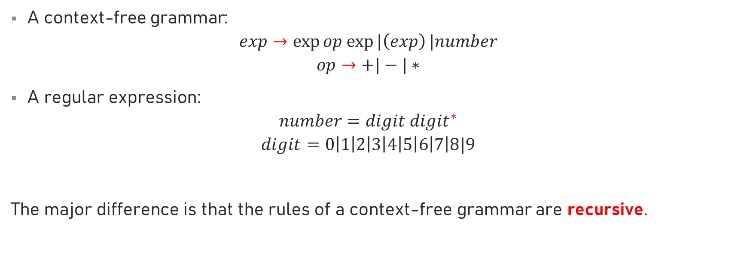
Comparisons between regular expressions and context-free grammars
A context-free grammar:
$$exp→\exp{op exp⁡|\left(exp\right)}|number$$
$$op→+|−|∗$$
A regular expression:
$$number=digit {digit}^{∗}$$
$$digit=0\left|1\right|2\left|3\right|4\left|5\right|6\left|7\right|8|9$$
The major difference is that the rules of a context-free grammar are recursive.

Slide 4
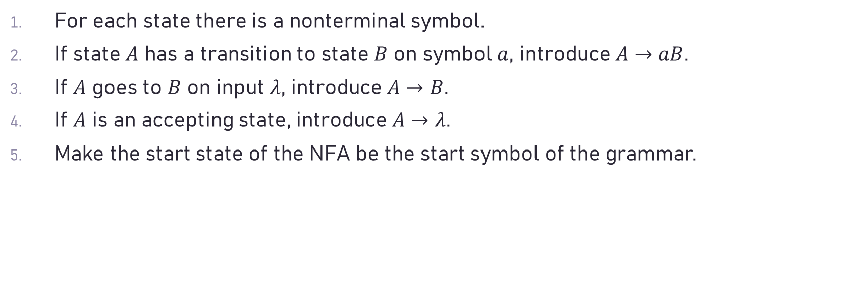
Rules from F.A.(r.e.) to CFG
For each state there is a nonterminal symbol.
If state $A$ has a transition to state $B$ on symbol $a$, introduce $A→aB$.
If $A$ goes to $B$ on input $λ$, introduce $A→B$.
If $A$ is an accepting state, introduce $A→λ$.
Make the start state of the NFA be the start symbol of the grammar.

Slide 5

Examples
(1) r.e.: (a|b)(a|b|0|1)*
c.f.g.: S $→$ aA|bA A $→$ aA|bA|0A|1A|𝜆
(2) r.e.: (a|b)*abb
c.f.g.: S $→$ aS | bS | aA
A $→$ bB
B $→$ bC
C $→$𝜆

Slide 6
Why don’t we use c.f.g. to replace r.e. ?
r.e. => easy & clear description for token.
r.e. => efficient token recognizer
modularizing the components (The grammar rules use regular expressions as components)

Slide 7
Features of programming languages
contents:
- declarations
- sequential statements
- iterative statements
- conditional statements

Slide 8
Description of programming languages
Syntax Diagrams
Context Free Grammars (CFG)

Slide 9
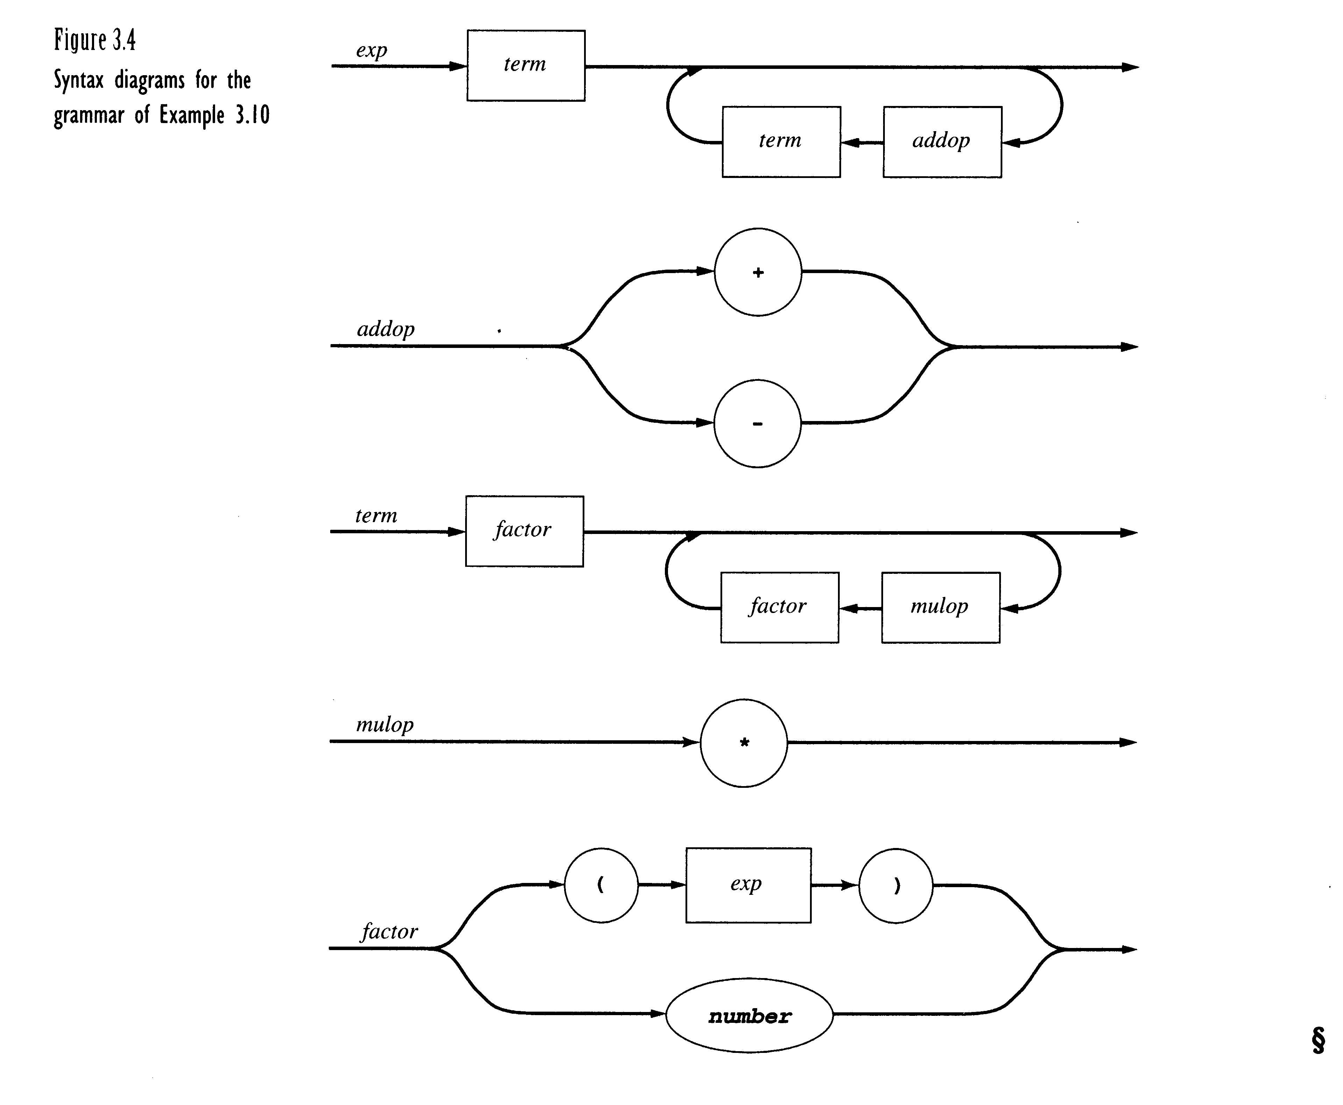

Slide 10
Contex Free Grammar (in BNF)
exp → exp addop term | term
addop → + | -
term → term mulop factor | factor
mulop →
*
factor → ( exp ) | number

Slide 11
History
In 1956 BNF (Backus Naur Form：巴科斯-諾爾範式) is used for description of natural language.
The Syntactic Specification of Programming Languages - CFG ( a BNF description)

Slide 12
Capabilities of Context-free grammars
give precise syntactic specification of programming languages
a parser can be constructed automatically by CFG
the syntax entity specified in CFG can be used for translating into object code.
useful for describing nested structures such as balanced parentheses, matching begin-end's, corresponding if-then-else, etc.

Slide 13
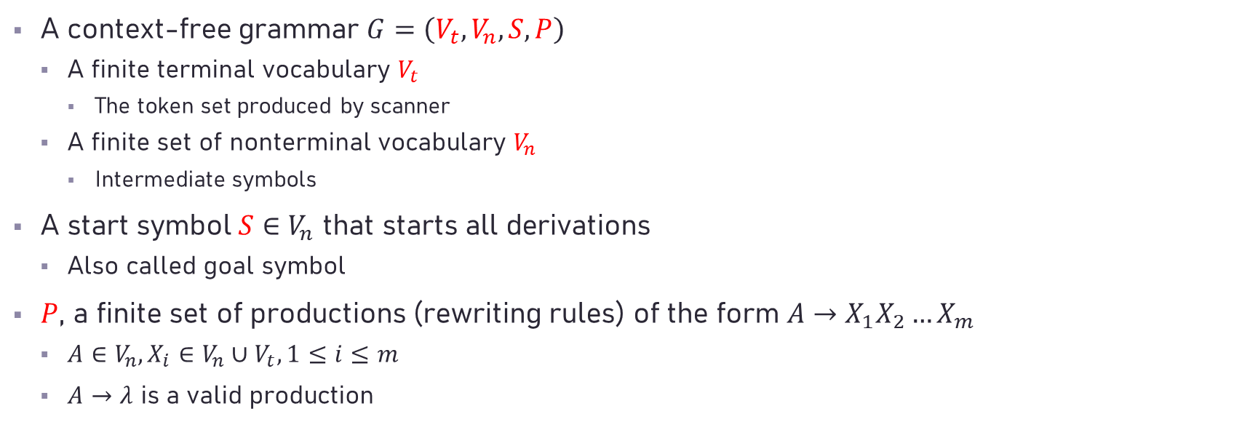
Context-Free Grammars: Concepts and Notation
A context-free grammar $G=\left(V_{t}, V_{n}, S, P\right)$
A finite terminal vocabulary $V_{t}$
The token set produced by scanner
A finite set of nonterminal vocabulary $V_{n}$
Intermediate symbols
A start symbol $S∈V_{n}$ that starts all derivations
Also called goal symbol
$P$, a finite set of productions (rewriting rules) of the form $A→X_{1}X_{2}…X_{m}$
$A∈V_{n},X_{i}∈V_{n}∪V_{t}, 1≤i≤m$
$A→λ$ is a valid production

Slide 14
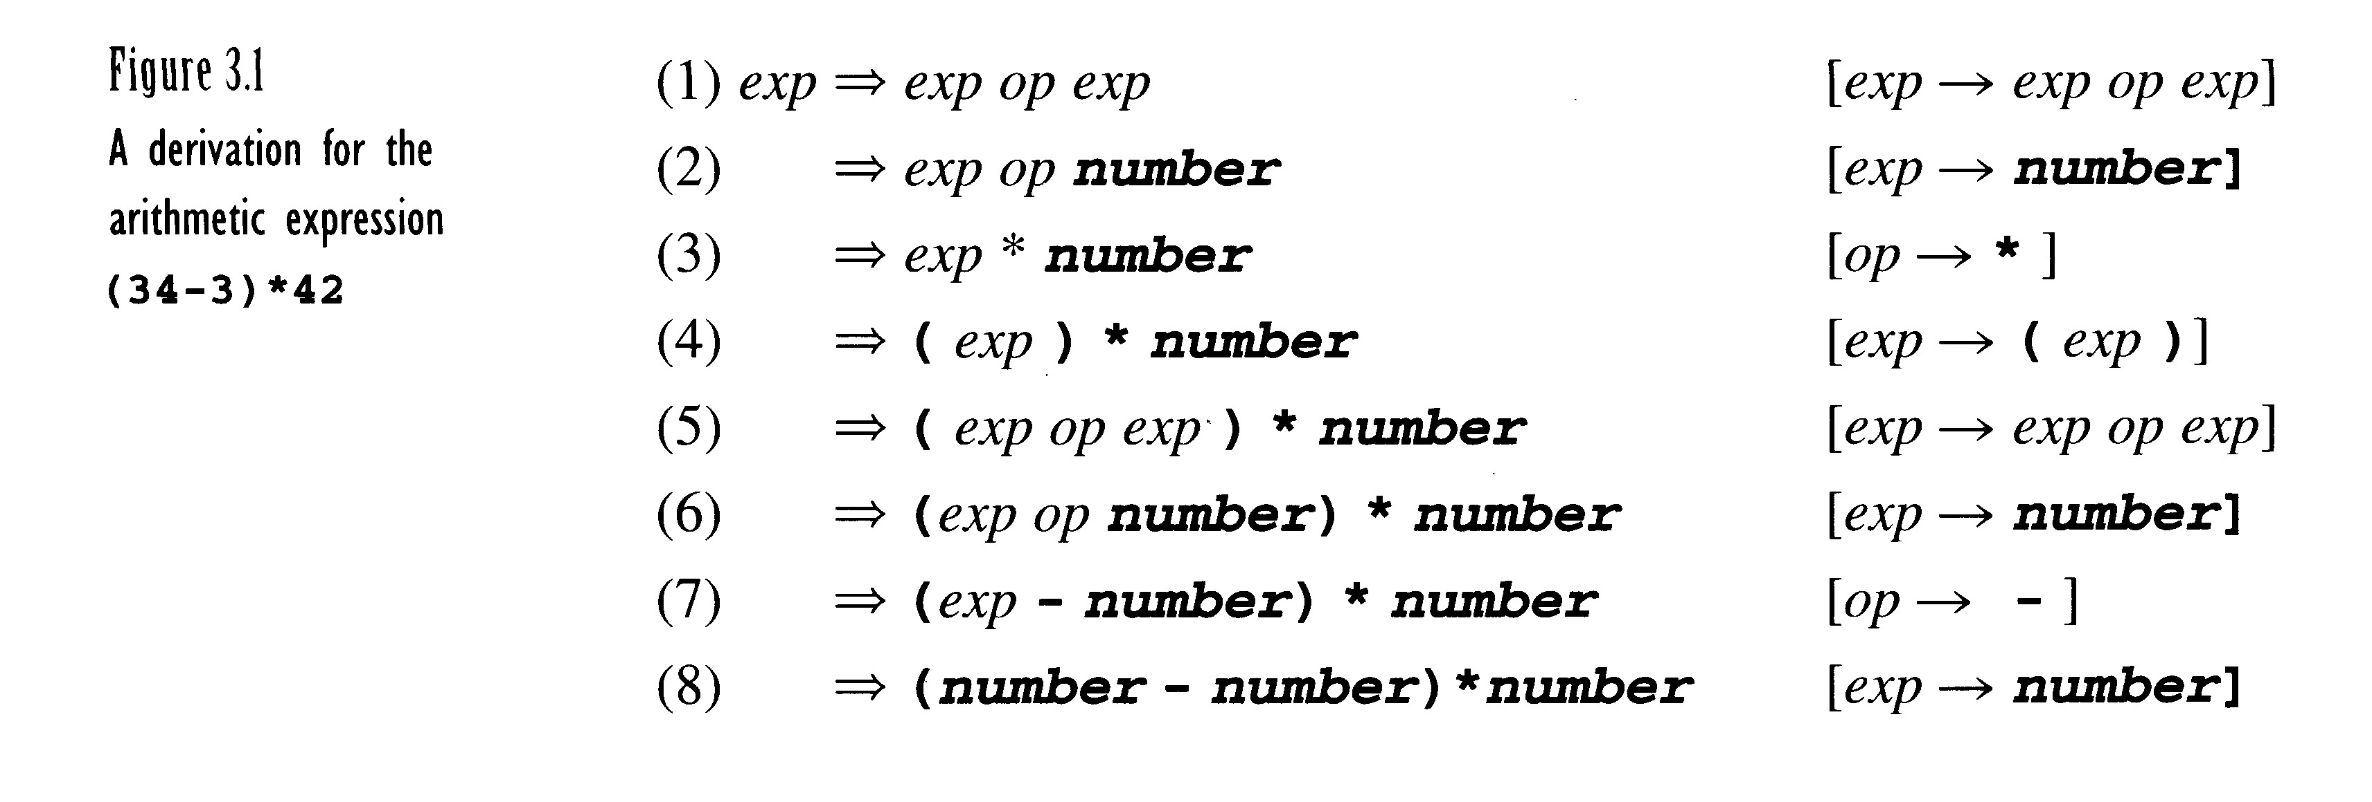
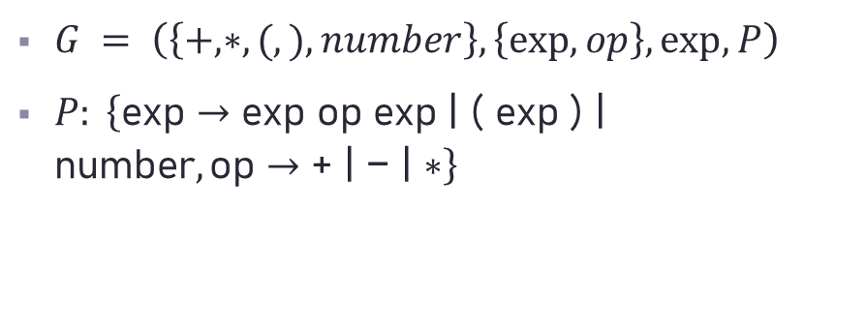
Context-Free Grammars: Concepts and Notation
$G = \left(\left\{+, ∗, (, ), number\right\},\left\{exp, op\right\}, exp, P\right)$
$P: \left\{\text{exp}→\text{exp} \text{op} \text{exp}\text{ | ( }\text{exp}\text{ ) | }\text{number},\text{op}→\text{+ | − | ∗}\right\}$
(number-number)*number

Slide 15

Context-Free Grammars: Concepts and Notation (Cont’d)
Other notations
Vocabulary $V$ of $G$,
$V=V_{n}∪V_{t}$
$L(G)$, the set of string $s$ derivable from $S$
Context-free language of grammar $G$
Notational conventions
$a,b,c, …$ denote symbols in $V_{t}$
$A,B,C, …$ denote symbols in $V_{n}$
$U,V,W,…$ denote symbols in $V$
$α, β, γ, …$ denote strings in $V^{∗}$
$u,v,w, …$ denote strings in $V_{t}^{∗}$

Slide 16
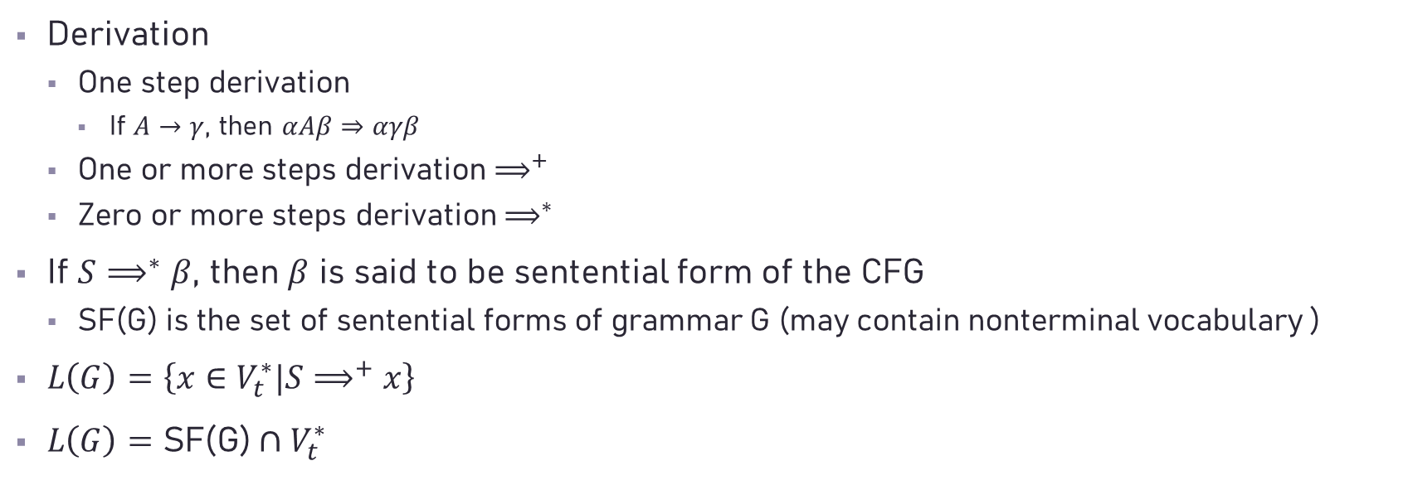
Context-Free Grammars: Concepts and Notation (Cont’d)
Derivation
One step derivation
If $A→γ$, then $αAβ⇒αγβ$
One or more steps derivation $⟹^{+}$
Zero or more steps derivation $⟹^{∗}$
If $S⟹^{∗}β$, then $β$ is said to be sentential form of the CFG
SF(G) is the set of sentential forms of grammar G (may contain nonterminal vocabulary )
$L\left(G\right)=\left\{x∈V_{t}^{∗}|S⟹^{+}x\right\}$
$L\left(G\right)=\text{SF}\text{(}\text{G}\text{)}∩V_{t}^{∗}$

Slide 17

Context-Free Grammars: Concepts and Notation (Cont’d)
Left-most derivation, a top-down parsers
$⇒_{lm}, ⇒_{lm}^{+},⇒_{lm}^{∗}$
E.g. of leftmost derivation of f(v+v)

Slide 18

Context-Free Grammars: Concepts and Notation (Cont’d)
Right-most derivation (canonical derivation)
$⇒_{rm}, ⇒_{rm}^{+},⇒_{rm}^{∗}$
E.g. of rightmost derivation of f(v+v)

Slide 19
$$E→T→T∗F→T∗id→F∗id→id∗id$$

Slide 20
Method | classic approach | modern approach
top-down | recursive descent | LL parsing (produce leftmost derivation)
bottom-up | operator precedence | LR parsing (shift-reduce parsing; produce rightmost derivation in reverse order)

Slide 21

Context-Free Grammars: Concepts and Notation (Cont’d)
A parse tree
rooted by the start symbol
Its leaves are grammar symbols or $λ$
a graphical representation for derivations.
(Note the difference between parse tree and syntax tree.)
Often the parse tree is produced in only a figurative sense; in reality, the parse tree exists only as a sequence of actions made by stepping through the tree construction process.

Slide 22
Errors in Context-Free Grammars
CFGs are a definitional mechanism. They may have errors, just as programs may.
Flawed CFG
Useless nonterminals
Unreachable
Derive no terminal string
S→A|B
A→a
B→Bb
C→c
Nonterminal C cannot be reached form S
Nonterminal B derives no terminal string
S is the start symbol.

Slide 23
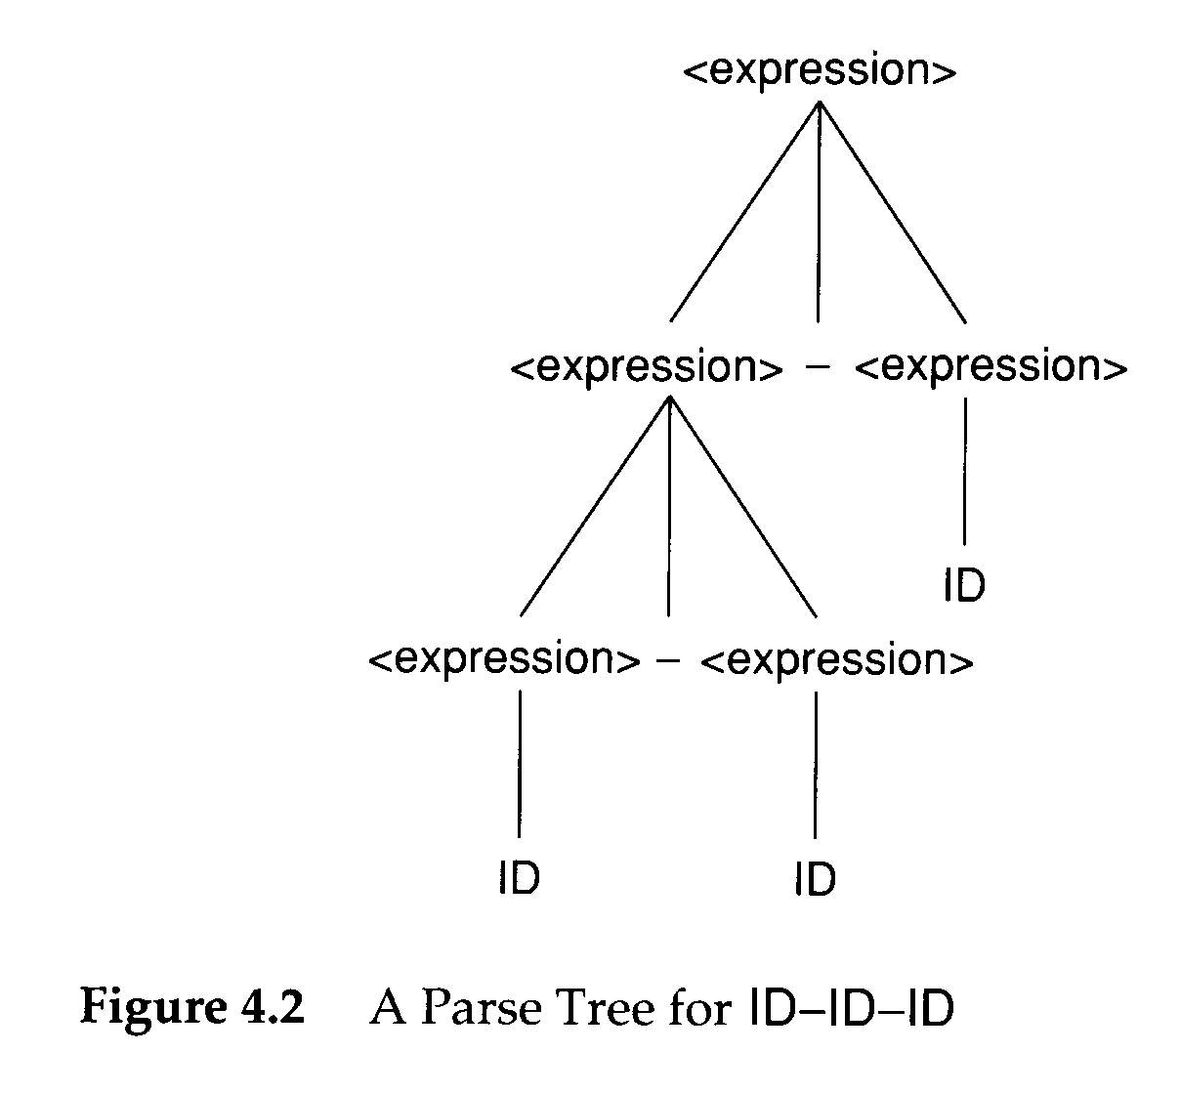
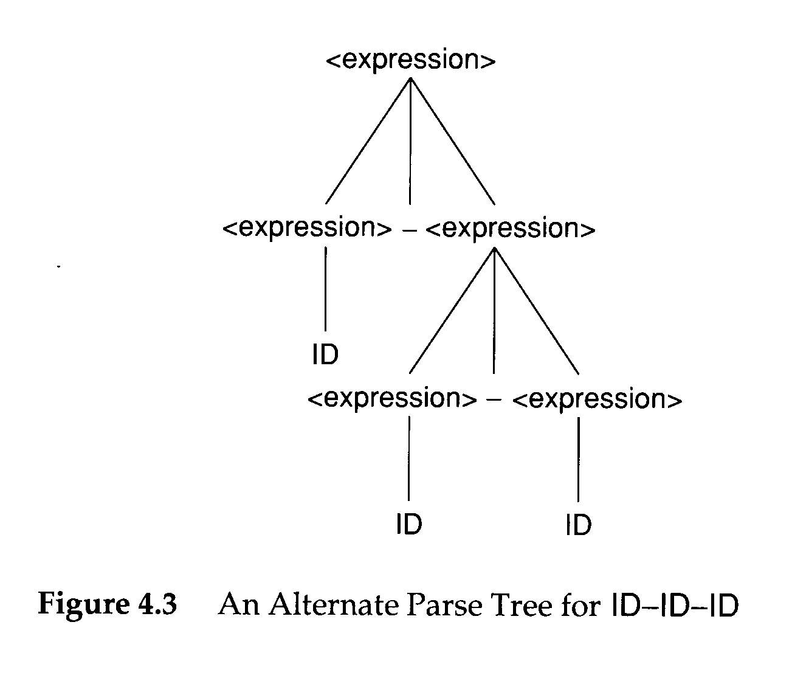
Errors in Context-Free Grammars
Ambiguous:
Grammars that allow different parse trees for the same terminal string
It is impossible to decide whether a given CFG is ambiguous

Slide 24
Ambiguity
Ambiguous Grammars
- Def.: A context-free grammar that can produce more than one parse tree for some sentence.
- The ways to disambiguate a grammar: (1) specifying the intention (e.g. associativity and precedence for arithmetic operators, other) (2) rewrite a grammar to incorporate the intention into the grammar itself.

Slide 25
For (1) Precedence: ( )>negate > exponent > * / > + －
Associativity: exponent → right associativity
others → left associativity
For (2) 1. introducing one nonterminal for each precedence level.

Slide 26
Example 1
E -> E + E | E－E | E * E | E / E | E ↑ E | ( E ) | - E | id
is ambiguous (↑ is exponent operator with right associativity.)

Slide 27
E
E
E
+
E
E
*
E
id
E
*
E
E
+
E
id
id
id
id
id
More than one parse tree for the sentence id + id * id

Slide 28
+
*
id
*
+
id
id
id
id
id
More than one syntax tree for the sentence id + id * id

Slide 29
The corresponding grammar shown below is unambiguous
element → (expression) | id /*((expression) 括號內的最優先做之故) */
primary → -primary | element
factor → primary ↑ factor | primary /*has right associativity */
term → term * factor | term / factor | factor
expression → expression + term | expression – term | term

Slide 30
Ex: id + id * id
expression
expression
+
term
term
term
*
factor
factor
factor
primary
primary
primary
element
element
element
id
id
id

Slide 31
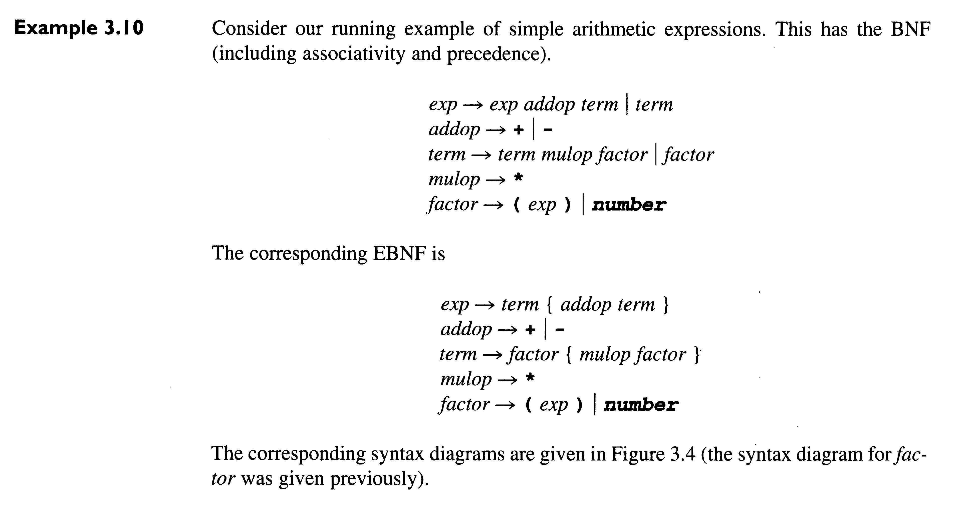

Slide 33
Example 2
stat → IF cond THEN stat | IF cond THEN stat ELSE stat | other stat
is an ambiguous grammar

Slide 34
Dangling else problem
stat
IF cond THEN stat
IF cond THEN stat ELSE stat
if c1 then
If c1 then if c2 then s2 else s3
if c2 then s2 else s3
stat
IF cond THEN stat ELSE stat
IF cond THEN stat
if
else
s3
c1
then
if
c2
then
s2

Slide 35
The corresponding grammar shown below is unambiguous.
stat → matched-stat | unmatched-stat
matched-stat → IF cond THEN matched-stat ELSE matched-stat | other-stat
unmatched-stat → IF cond THEN stat | IF cond THEN matched-stat ELSE unmatched-stat

Slide 36
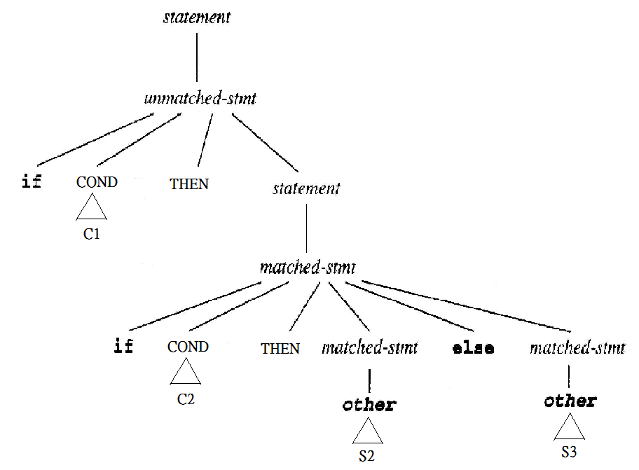

Slide 37
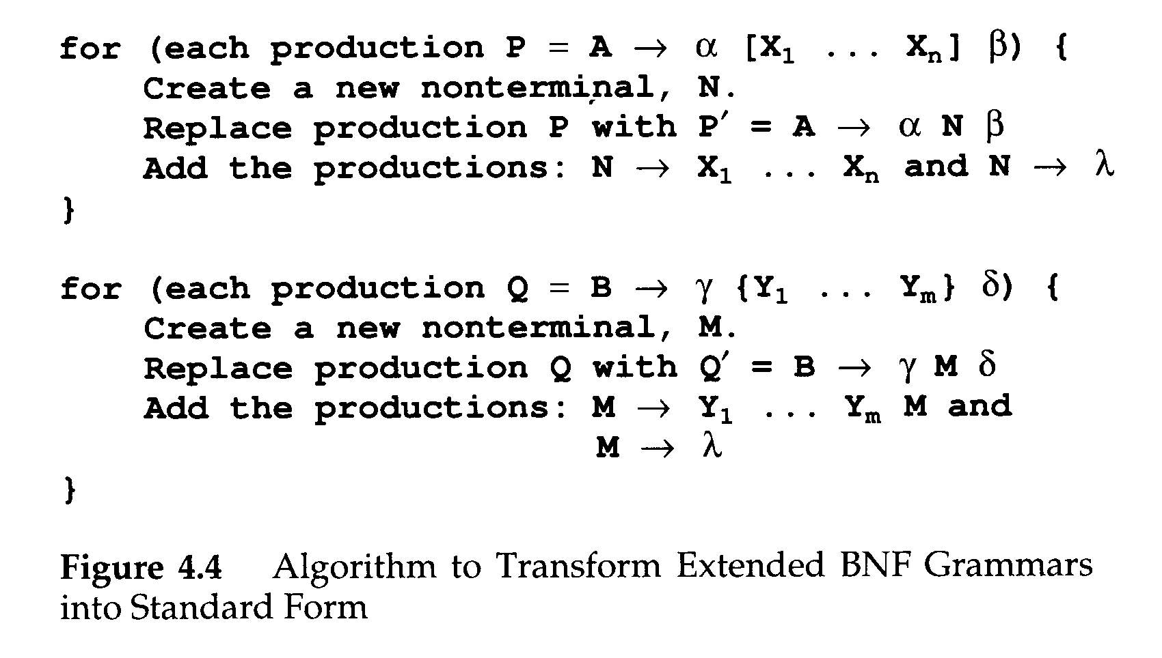

Transforming Extened BNF Grammars
Extended BNF$≡$BNF
Extended BNF allows
Square bracket []
Optional list {}

Slide 40
Parsers and Recognizers
Recognizer
An algorithm that does boolean-valued test
“Is this input syntactically valid?
Parser
Answers more general questions
Is this input valid?
And, if it is, what is its structure (parse tree)?

Slide 41
Parsers and Recognizers (Cont’d)
Two general approaches to parsing
Top-down parser
Expanding the parse tree (via predictions) in a depth-first manner
Preorder traversal of the parse tree
Predictive in nature
lm
LL

Slide 42
Parsers and Recognizers (Cont’d)
Buttom-down parser
Beginning at its bottom (the leaves of the tree, which are terminal symbols) and determining the productions used to generate the leaves
Postorder traversal of the parse tree
rm
LR

Slide 43
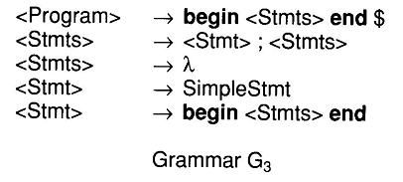
Parsers and Recognizers (Cont’d)
To parse
begin SimpleStmt; SimpleStmt; end $

Slide 44
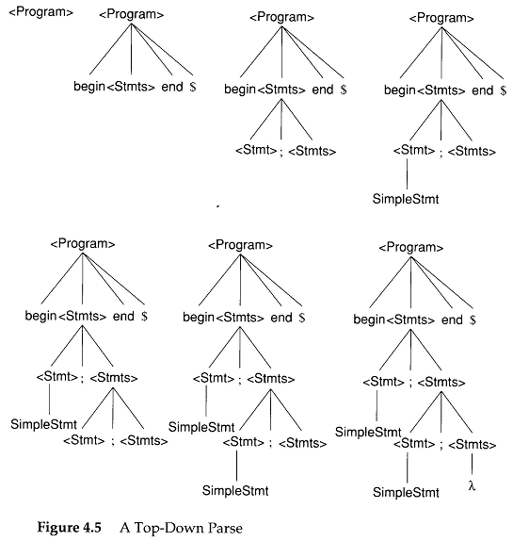

Slide 45
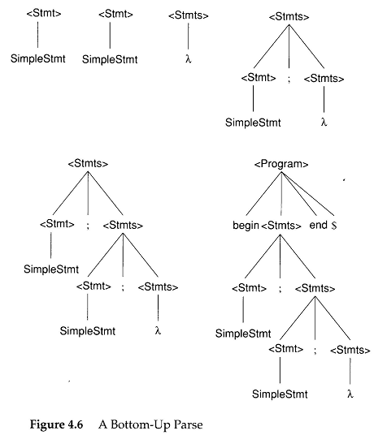

Slide 46
Parsers and Recognizers (Cont’d)
Naming of parsing techniques
Top-down
LL
Bottom-up
LR
The way to parse
token sequence
L: Leftmost
R: Righmost

Slide 47
Grammar Analysis Algorithms
Goal of this section:
Discuss a number of important analysis algorithms for Grammars

Slide 48
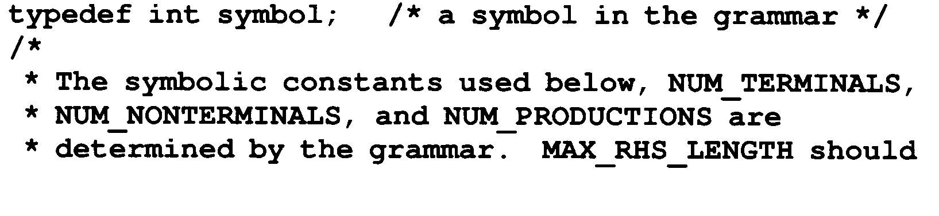
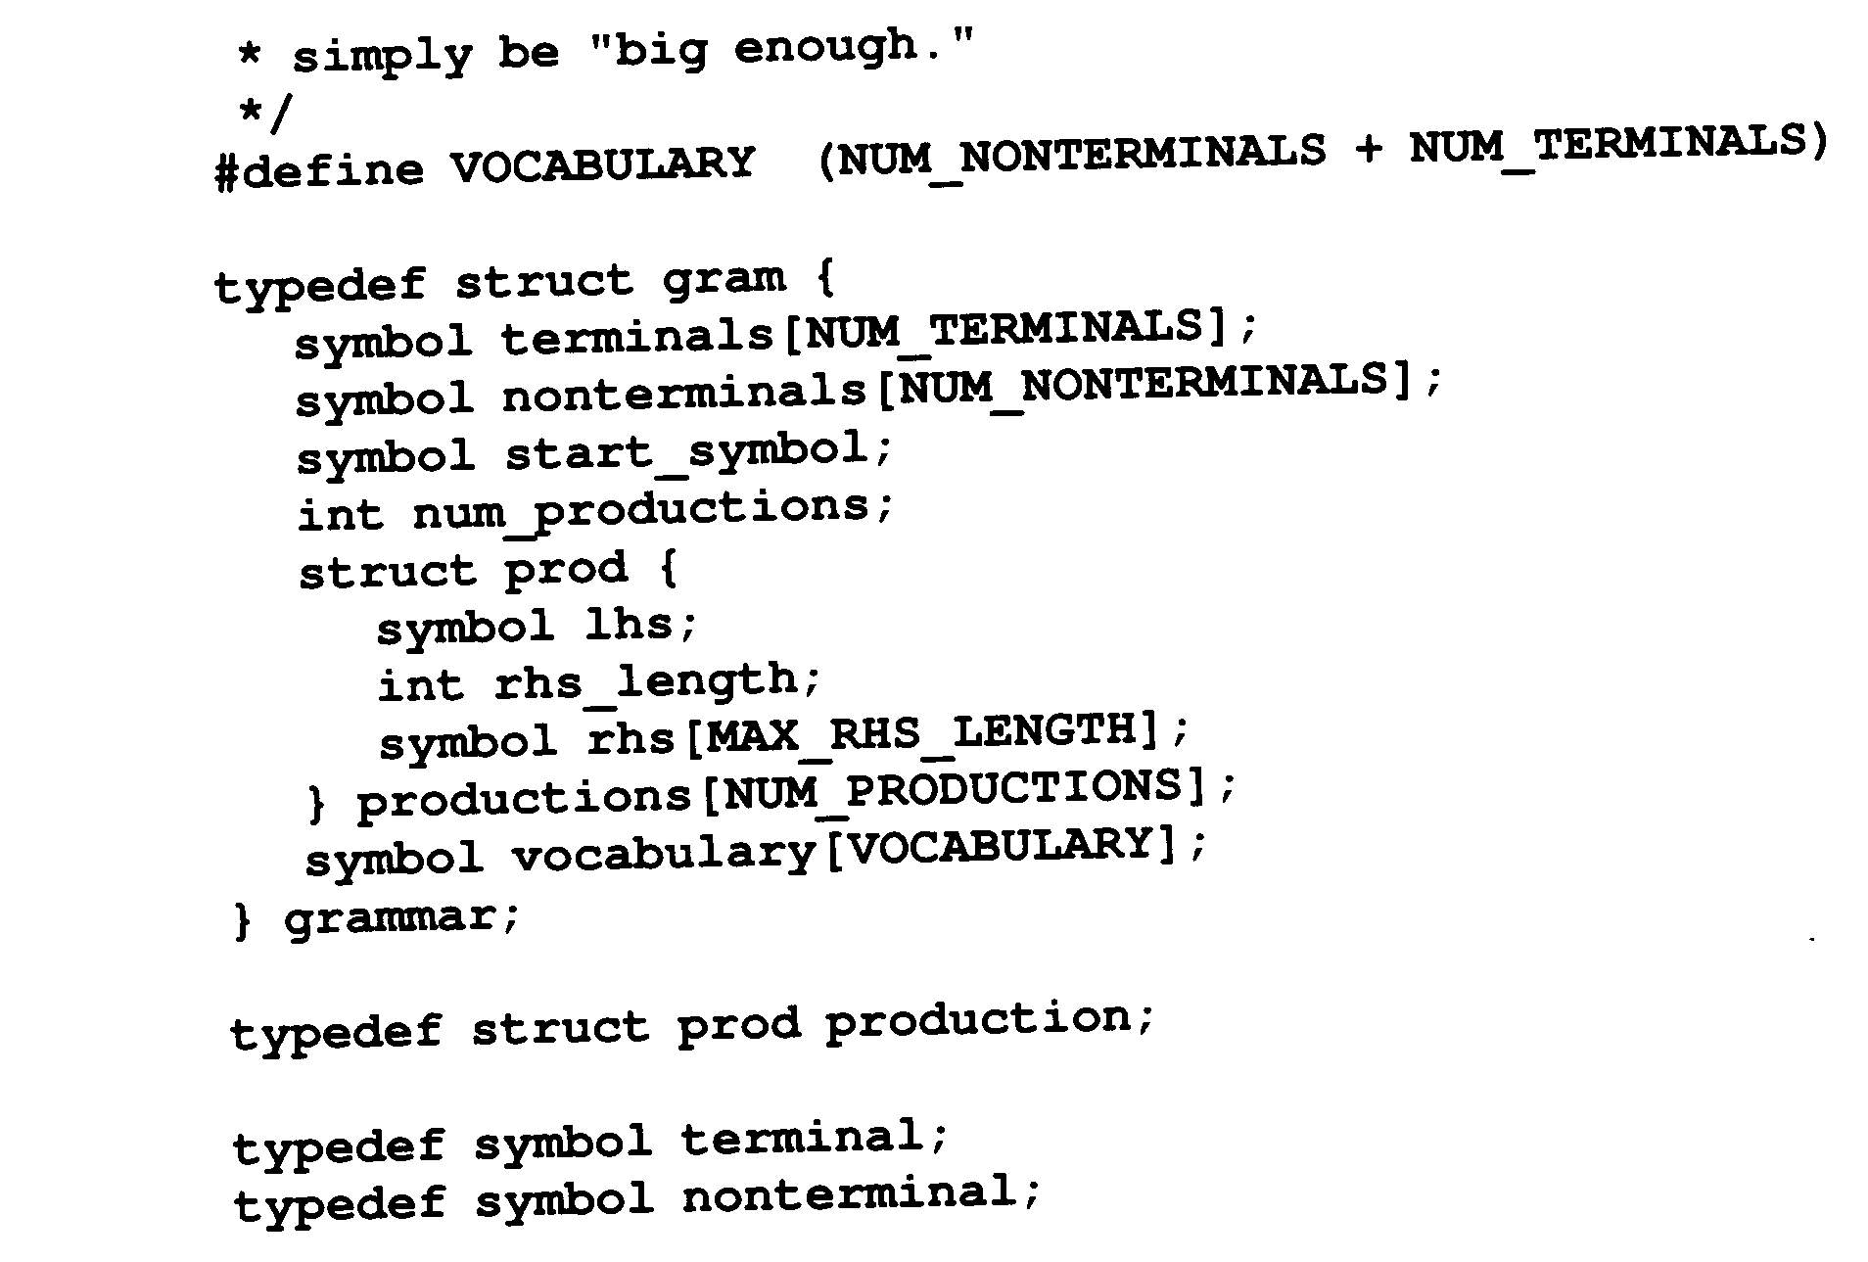
Grammar Analysis Algorithms (Cont’d)
The data structure of a grammar G

Slide 49
Grammar Analysis Algorithms (Cont’d)
What nonterminals can derive λ?
A ⇒ BCD ⇒ BC ⇒ B ⇒ λ
An iterative marking algorithm

Slide 50
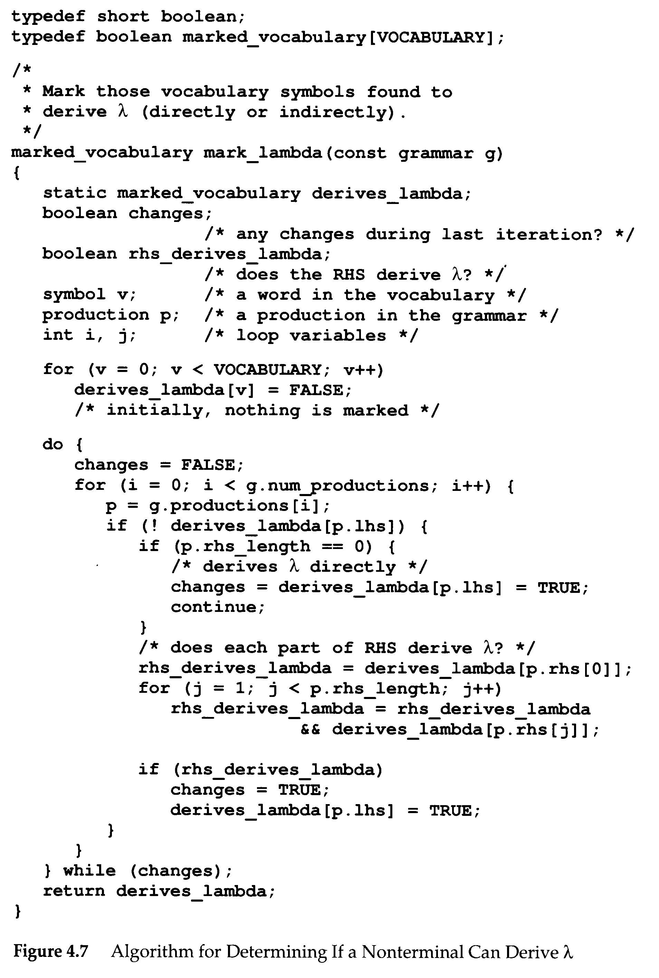

Slide 51
Grammar Analysis Algorithms (Cont’d)

Slide 52
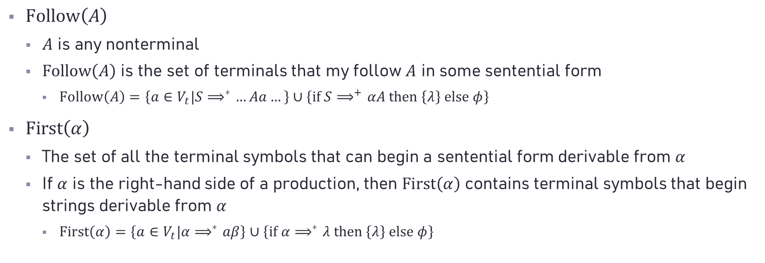
Grammar Analysis Algorithms (Cont’d)
$Follow\left(A\right)$
$A$ is any nonterminal
$Follow\left(A\right)$ is the set of terminals that my follow $A$ in some sentential form
$Follow\left(A\right)=\left\{a∈V_{t}|S⟹^{∗}…Aa…\right\}∪\left\{if S⟹^{+}αA then \left\{λ\right\} else φ\right\}$
$First\left(α\right)$
The set of all the terminal symbols that can begin a sentential form derivable from $α$
If $α$ is the right-hand side of a production, then $First\left(α\right)$ contains terminal symbols that begin strings derivable from $α$
$First\left(α\right)=\left\{a∈V_{t}|α⟹^{∗}aβ\right\}∪\left\{if α⟹^{∗}λ then \left\{λ\right\} else φ\right\}$

Slide 53

Grammar Analysis Algorithms (Cont’d)
Definition of C data structures and subroutines
$first_set[X]$
contains terminal symbols and $λ$
$X$ is any single vocabulary symbol
$follow_set[A]$
contains terminal symbols and $λ$
$A$ is a nonterminal symbol

Slide 54
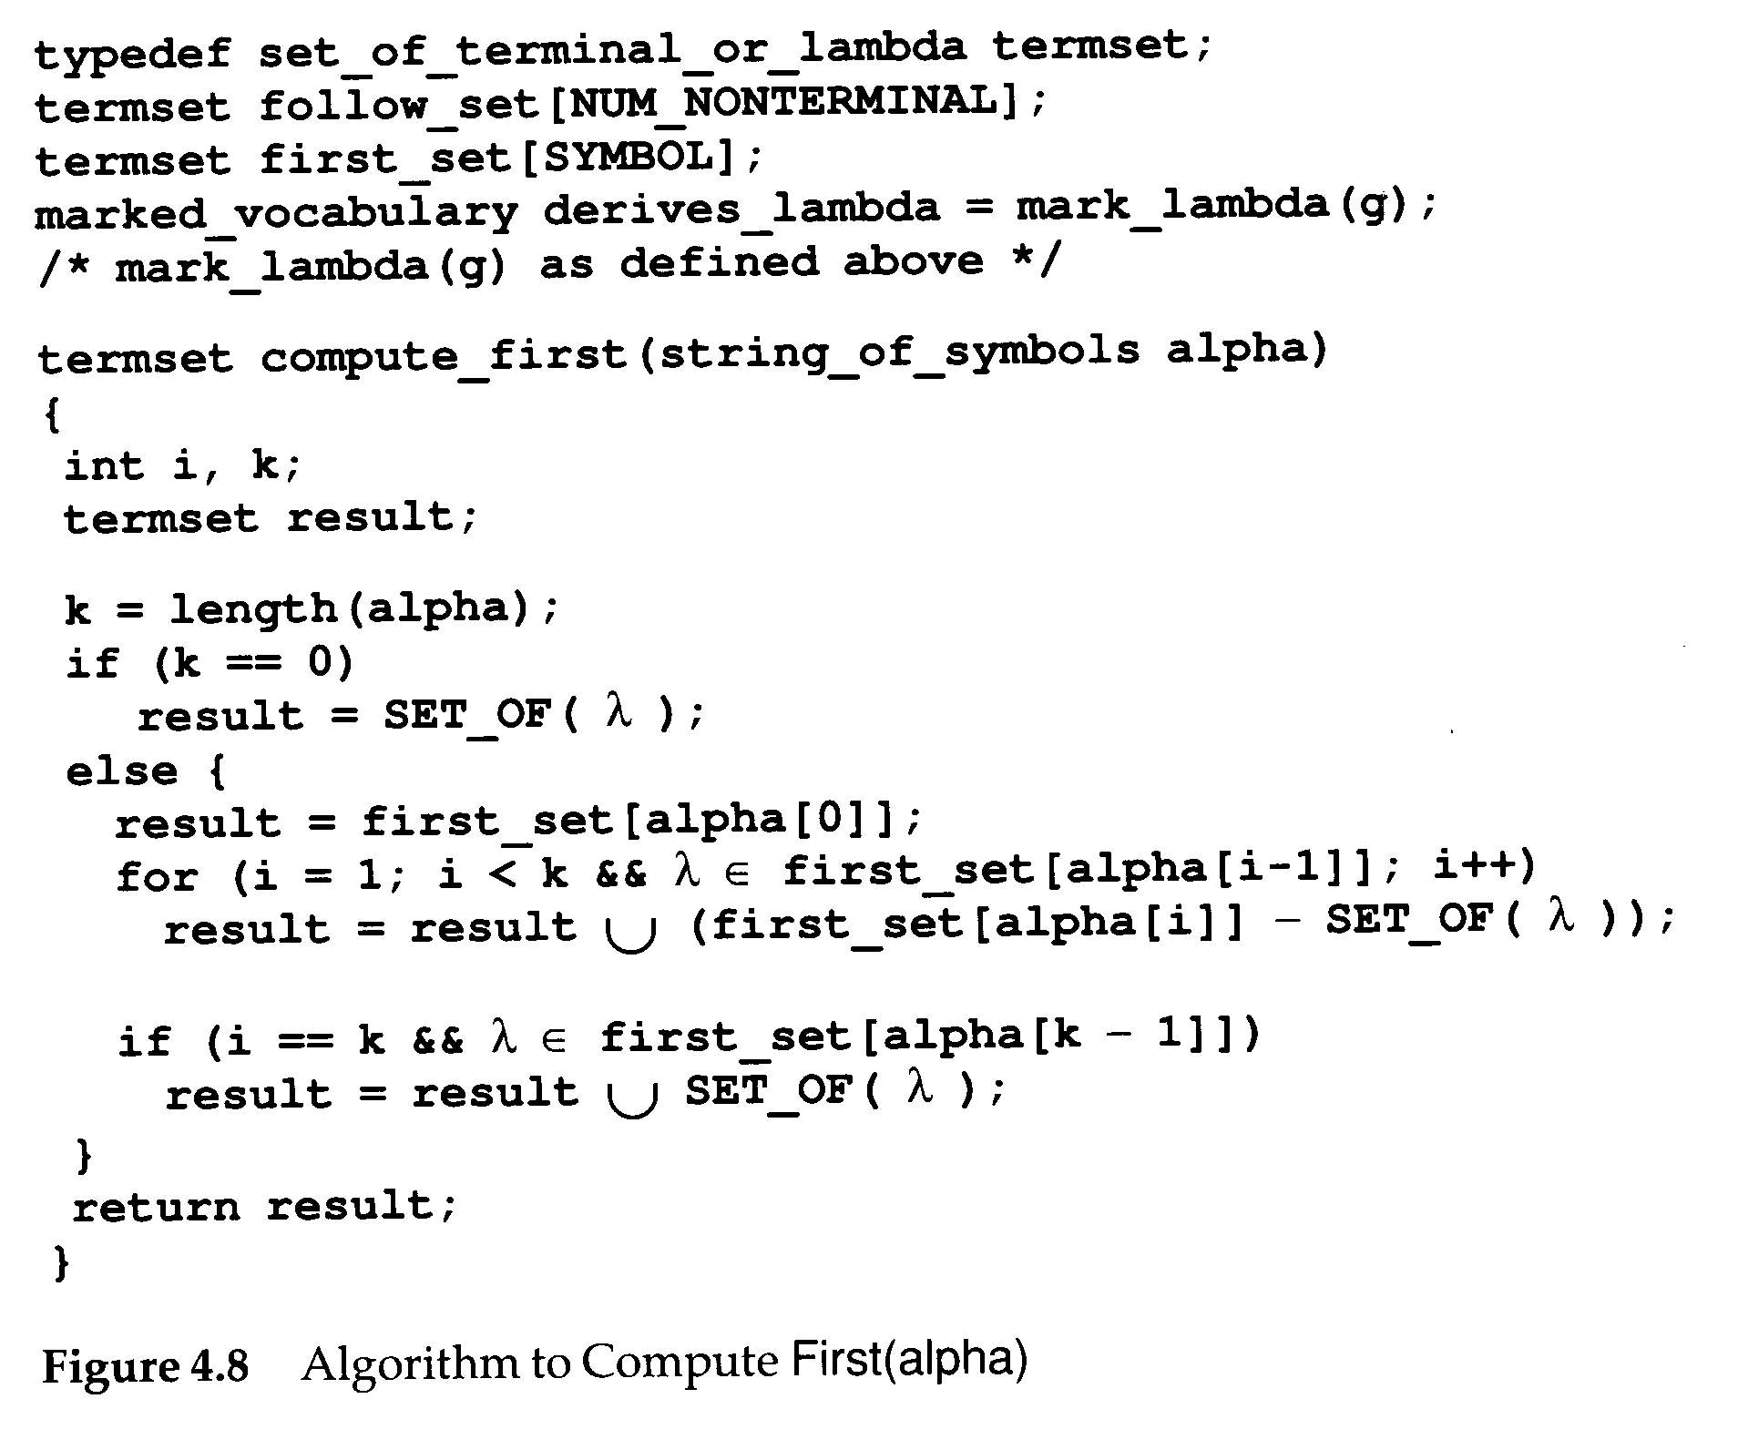
It is a subroutine of
fill_first_set()

Slide 55
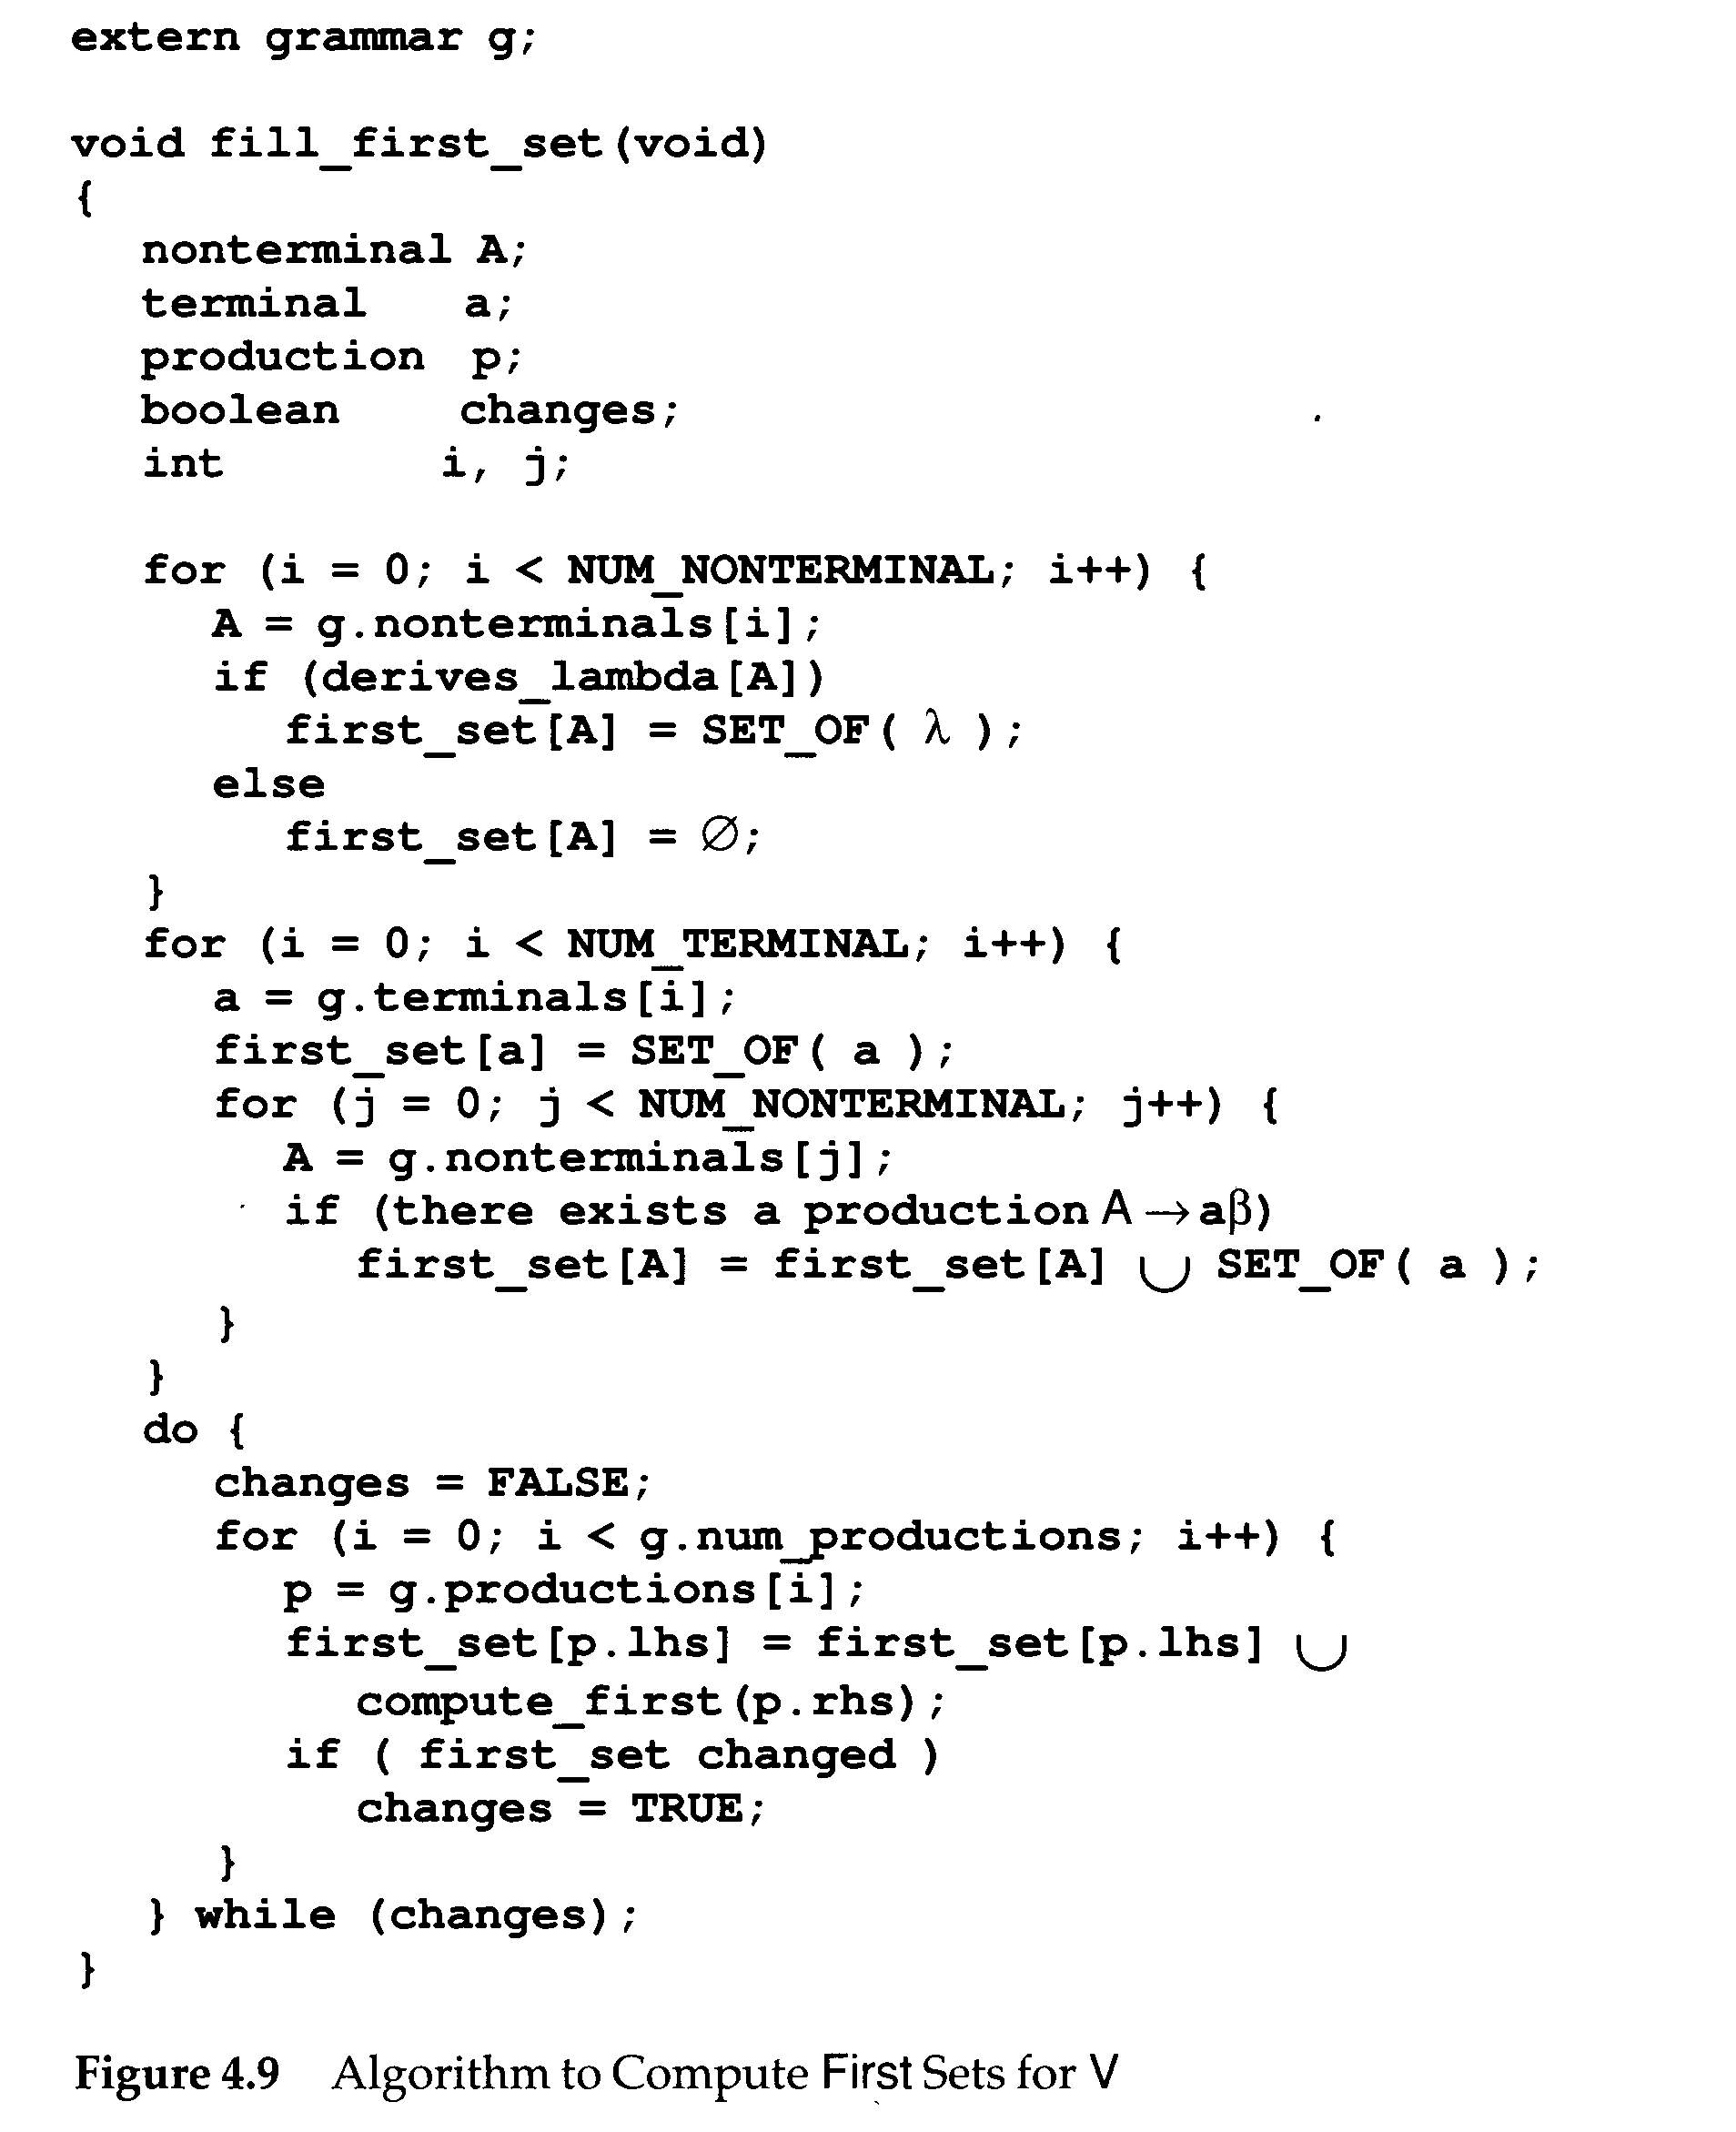

Slide 56
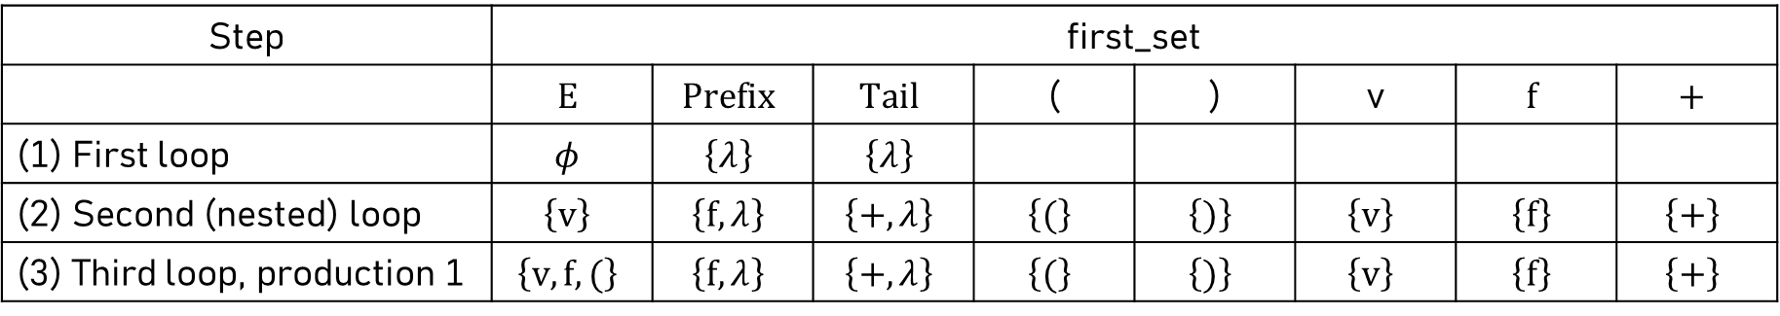
The execution of fill_first_set() using grammar G₀
Step | first_set
 | $$E$$ | $$Prefix$$ | $$Tail$$ | ( | ) | v | $$f$$ | $$+$$
(1) First loop | $$φ$$ | $$\left\{λ\right\}$$ | $$\left\{λ\right\}$$
(2) Second (nested) loop | $$\left\{v\right\}$$ | $$\left\{f,λ\right\}$$ | $$\left\{+, λ\right\}$$ | $$\left\{(\right\}$$ | $$\left\{)\right\}$$ | $$\left\{v\right\}$$ | $$\left\{f\right\}$$ | $$\left\{+\right\}$$
(3) Third loop, production 1 | $$\left\{v, f, (\right\}$$ | $$\left\{f,λ\right\}$$ | $$\left\{+, λ\right\}$$ | $$\left\{(\right\}$$ | $$\left\{)\right\}$$ | $$\left\{v\right\}$$ | $$\left\{f\right\}$$ | $$\left\{+\right\}$$

Slide 57
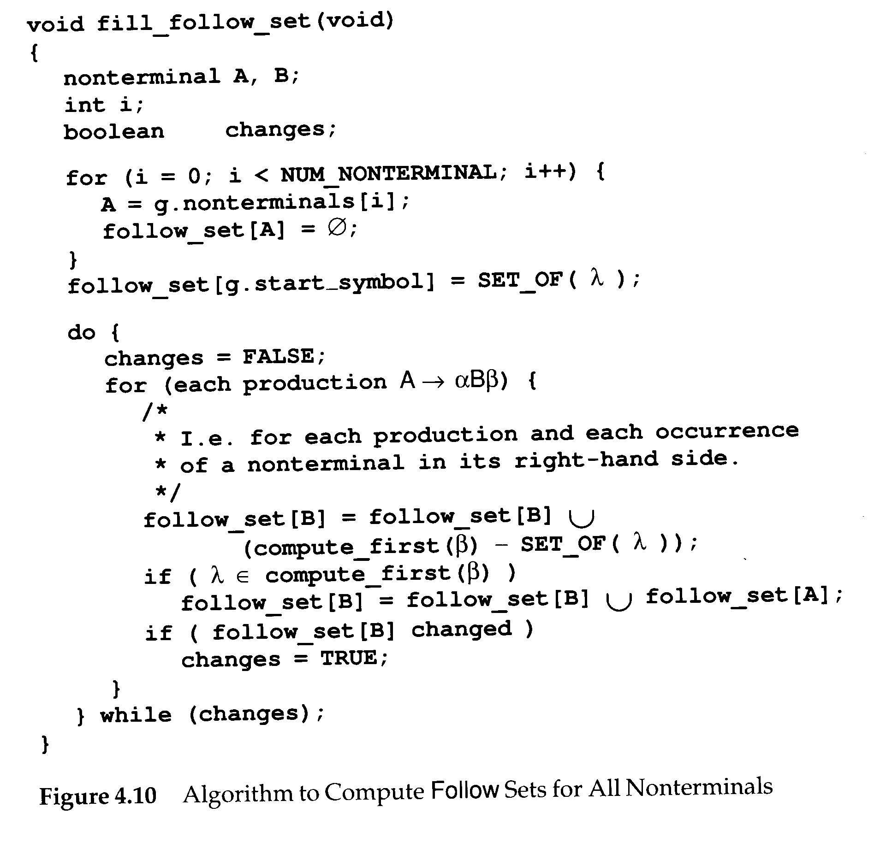

Slide 58
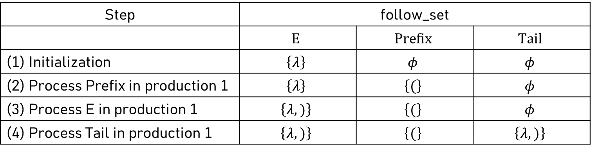
The execution of fill_follow_set() using grammar G₀
Step | follow_set
 | $$E$$ | $$Prefix$$ | $$Tail$$
(1) Initialization | $$\left\{λ\right\}$$ | $$φ$$ | $$φ$$
(2) Process Prefix in production 1 | $$\left\{λ\right\}$$ | $$\left\{(\right\}$$ | $$φ$$
(3) Process E in production 1 | $$\left\{λ, )\right\}$$ | $$\left\{(\right\}$$ | $$φ$$
(4) Process Tail in production 1 | $$\left\{λ, )\right\}$$ | $$\left\{(\right\}$$ | $$\left\{λ, )\right\}$$

Slide 59
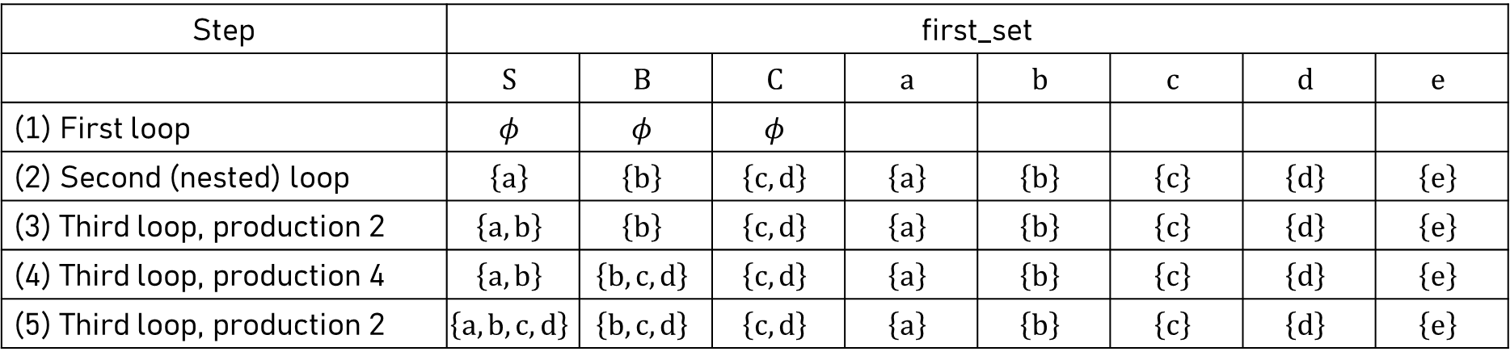
More examples
S → aSe
S → B
B → bBe
B → C
C → cCe
C → d
Step | first_set
 | $$S$$ | $$B$$ | $$C$$ | $$a$$ | $$b$$ | $$c$$ | $$d$$ | $$e$$
(1) First loop | $$φ$$ | $$φ$$ | $$φ$$
(2) Second (nested) loop | $$\left\{a\right\}$$ | $$\left\{b\right\}$$ | $$\left\{c, d\right\}$$ | $$\left\{a\right\}$$ | $$\left\{b\right\}$$ | $$\left\{c\right\}$$ | $$\left\{d\right\}$$ | $$\left\{e\right\}$$
(3) Third loop, production 2 | $$\left\{a, b\right\}$$ | $$\left\{b\right\}$$ | $$\left\{c, d\right\}$$ | $$\left\{a\right\}$$ | $$\left\{b\right\}$$ | $$\left\{c\right\}$$ | $$\left\{d\right\}$$ | $$\left\{e\right\}$$
(4) Third loop, production 4 | $$\left\{a, b\right\}$$ | $$\left\{b, c, d\right\}$$ | $$\left\{c, d\right\}$$ | $$\left\{a\right\}$$ | $$\left\{b\right\}$$ | $$\left\{c\right\}$$ | $$\left\{d\right\}$$ | $$\left\{e\right\}$$
(5) Third loop, production 2 | $$\left\{a, b, c, d\right\}$$ | $$\left\{b, c, d\right\}$$ | $$\left\{c, d\right\}$$ | $$\left\{a\right\}$$ | $$\left\{b\right\}$$ | $$\left\{c\right\}$$ | $$\left\{d\right\}$$ | $$\left\{e\right\}$$

Slide 60
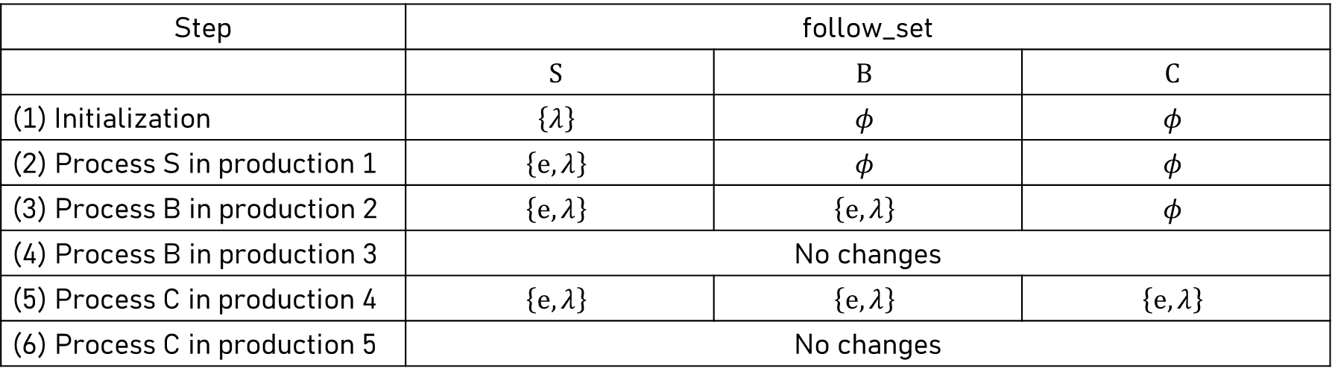
More examples
S → aSe
S → B
B → bBe
B → C
C → cCe
C → d
Step | follow_set
 | $$S$$ | $$B$$ | $$C$$
Initialization | $$\left\{λ\right\}$$ | $$φ$$ | $$φ$$
(2) Process S in production 1 | $$\left\{e,λ\right\}$$ | $$φ$$ | $$φ$$
(3) Process B in production 2 | $$\left\{e,λ\right\}$$ | $$\left\{e,λ\right\}$$ | $$φ$$
(4) Process B in production 3 | No changes
(5) Process C in production 4 | $$\left\{e,λ\right\}$$ | $$\left\{e,λ\right\}$$ | $$\left\{e,λ\right\}$$
(6) Process C in production 5 | No changes

Slide 61
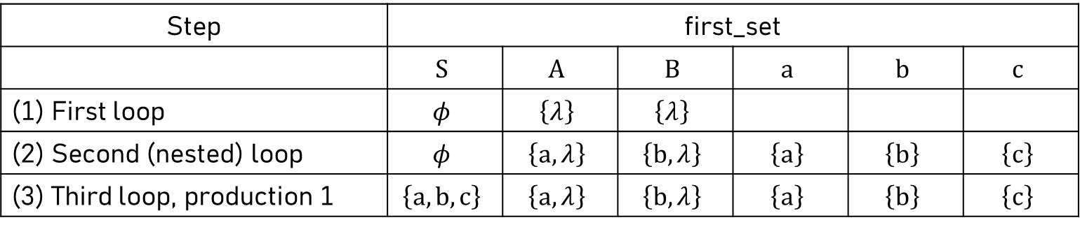
More examples
S → ABc
A → a
A → λ
B → b
B → λ
Step | first_set
 | $$S$$ | $$A$$ | $$B$$ | $$a$$ | $$b$$ | $$c$$
(1) First loop | $$φ$$ | $$\left\{λ\right\}$$ | $$\left\{λ\right\}$$
(2) Second (nested) loop | $$φ$$ | $$\left\{a,λ\right\}$$ | $$\left\{b,λ\right\}$$ | $$\left\{a\right\}$$ | $$\left\{b\right\}$$ | $$\left\{c\right\}$$
(3) Third loop, production 1 | $$\left\{a, b, c\right\}$$ | $$\left\{a,λ\right\}$$ | $$\left\{b,λ\right\}$$ | $$\left\{a\right\}$$ | $$\left\{b\right\}$$ | $$\left\{c\right\}$$

Slide 62
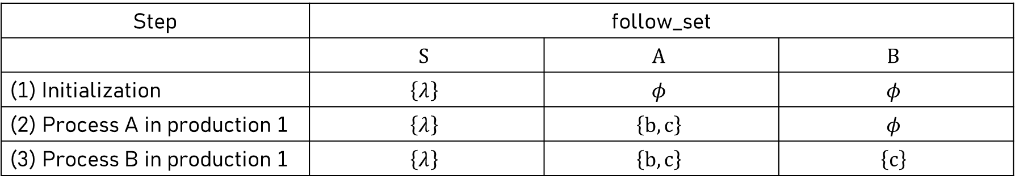
More examples
S → ABc
A → a
A → λ
B → b
B → λ
Step | follow_set
 | $$S$$ | $$A$$ | $$B$$
Initialization | $$\left\{λ\right\}$$ | $$φ$$ | $$φ$$
(2) Process A in production 1 | $$\left\{λ\right\}$$ | $$\left\{b,c\right\}$$ | $$φ$$
(3) Process B in production 1 | $$\left\{λ\right\}$$ | $$\left\{b,c\right\}$$ | $$\left\{c\right\}$$

